Slide 1
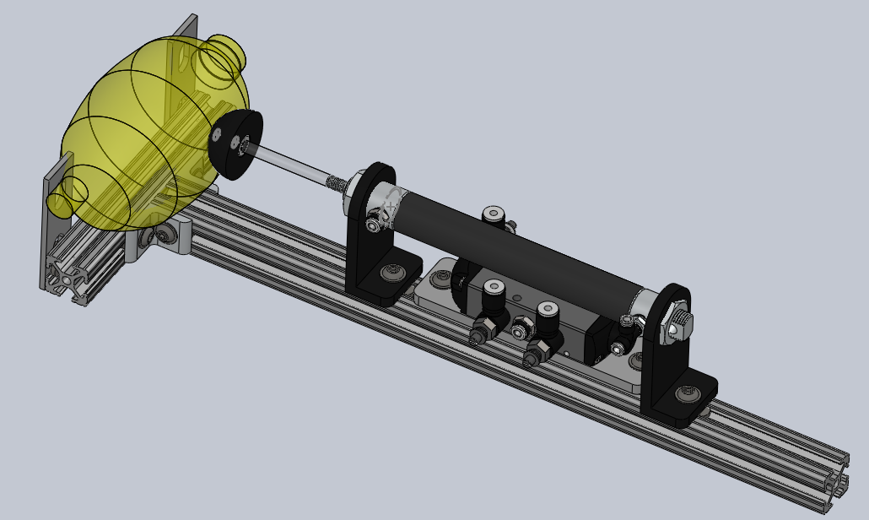
Pneumatically Automated Bag Vent Kaelan Schorger April 2020

Slide 2
Key Principles
Small number of assembly elements, inexpensive, no custom components other than fixtures.
It is entirely pneumatic and requires no electronic elements or power supply, only compressed air.
Relative inspiratory and expiratory timing can be independently adjusted with flow control valves on the respective exhaust ports of the 5/2 valve
“Cycle time” is controlled using the flow control valve connected to the control air inlet of the 5/2 valve
Tidal volume can be adjusted by increasing or decreasing flow through inspiratory and expiratory flow valves in tandem relative to the cycle timing valve. Additionally larger changes can be accomplished by changing the position of the cylinder and fixtures on the frame.

Slide 3
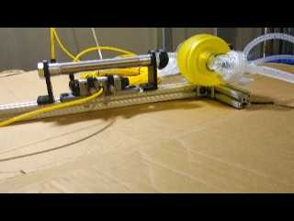

Slide 4
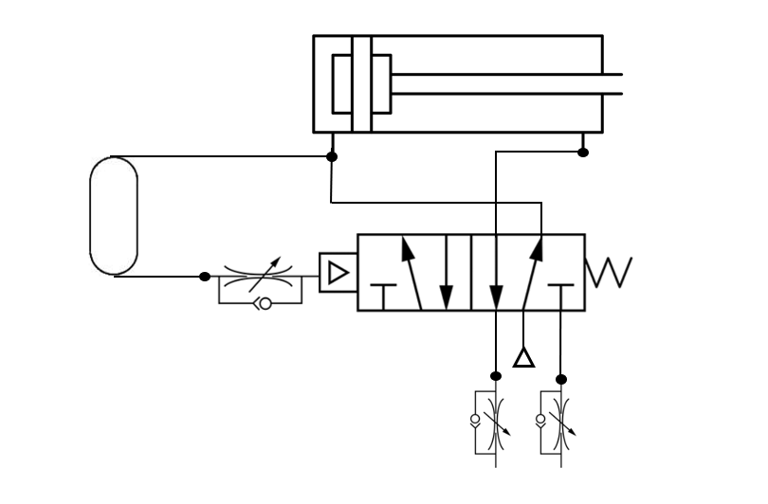
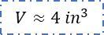
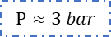
Pneumatic Circuit
$$V≈4 {in}^{3}$$
Cycle Timing Valve (low relative flow rate)
$$P≈3 bar$$
Inspiratory Timing Valve
Expiratory Timing Valve

